Slide 1

Chapter 1 Introduction
Computer Networking: A Top-Down Approach 8th edition Jim Kurose, Keith Ross Pearson, 2020
Acknowledgement: Based on the textbook’s website: https://gaia.cs.umass.edu/kurose_ross/index.php
Notes:
(8.2)Version
7.2 (January 2020)
All slides reformatted for 16:9 aspect ratio
Use of Calibri font, rather that Gill Sans MT
Updated slide content for 2020 link technologies and applications
Add more animation throughout
New Master slide
Feb. 2020 (8.0)
a few updates suggest by Catherine Rosenberg (thanks!)
titles in a lighter font
Sept 2020 (8.1)
Added ~7 new slides, in particular: data center slide; routing versus forwarding; security line of defense; several on encapsulation and layers (this section is a lot better now). Other relative minor changes throughout
Feb. 2023 (8.2)
few minor updates (mostly speeds, technology details)

Slide 2

Chapter 1: roadmap
What is the Internet?
What is a protocol?
Network edge: hosts, access network, physical media
Network core: packet/circuit switching, internet structure
Performance: loss, delay, throughput
Security
Protocol layers, service models

Slide 3

How do packet delay and loss occur?
IMPORTANT
packets queue in router buffers, waiting for turn for transmission
queue length grows when arrival rate to link (temporarily) exceeds output link capacity
packet loss occurs when memory to hold queued packets fills up
packet being transmitted (transmission delay)
A
B
packets in buffers (queueing delay)
free (available) buffers: arriving packets
dropped (loss) if no free buffers

Slide 4
Packet delay: four sources
IMPORTANT
transmission
A
propagation
B
nodal
processing
queueing
d_{nodal} = d_{proc} + d_{queue} + d_{trans} + d_{prop}
d_{proc}: nodal processing
check bit errors
determine output link
typically < microsecs
d_{queue}: queueing delay
time waiting at output link for transmission
depends on congestion level of router

Slide 5
Packet delay: four sources
IMPORTANT
transmission
A
propagation
B
nodal
processing
queueing
d_{nodal} = d_{proc} + d_{queue} + d_{trans} + d_{prop}
d_{trans}: transmission delay:
L: packet length (bits)
R: link transmission rate (bps)
d_{trans} = L/R
d_{prop}: propagation delay:
d: length of physical link
s: propagation speed (~2x10⁸ m/sec)
d_{prop} = d/s
d_{trans} and d_{prop}
very different

Slide 6

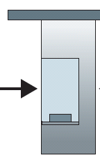
Caravan analogy
IMPORTANT
100 km
ten-car caravan
(aka 10-bit packet)
toll booth 1
(aka link)
toll booth 2
toll booth 3
car ~ bit; caravan ~ packet; toll service ~ link transmission
toll booth takes 12 sec to service car (bit transmission time)
“propagate” at 100 km/hr
Q: How long until all caravans (packets) arrive at 2nd toll booth?
time to “push” entire caravan through toll booth onto highway = 12*10 = 120 sec
time for last car to propagate from 1st to 2nd toll both: 100km/(100km/hr) = 1 hr
A: 62 minutes

Slide 7
How long until all cars (packets) arrive at 2nd toll booth
IMPORTANT
Transmission
delay at
toll booth 1
……
C1
C2
C3
C4
C5
C1
Propagation delay
From toll booth 1 to toll booth 2
C2
C3
C4
C5
……
Total delay
Total delay for sending all cars from source to toll booth 1 to toll booth 2 =
Transmission delay of all cars (also the last car) at toll booth 1 = 12*10 (120 sec), plus
Propagation delay of the last car from toll booth 1 to toll booth 2 = 100km/(100km/hr) (1 hr)
= 62 minutes

Slide 8
Caravan analogy
IMPORTANT
100 km
100 km
ten-car caravan
(aka 10-bit packet)
toll booth
(aka router)
toll booth
suppose cars now “propagate” at 1000 km/hr
and suppose toll booth now takes one min to service a car
Q: Will cars arrive to 2nd booth before all cars serviced at first booth?
A: Yes! after 7 min, first car arrives at second booth; three cars still at first booth
1st car: transmission delay 1 min + prop delay 100km/(1000km/hr) = 0.1 hr=6 min

Slide 9
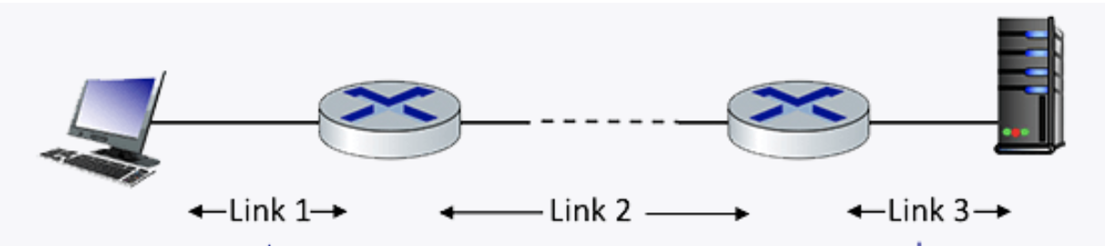
Quiz
IMPORTANT
Performance: Delay. Consider the network shown in the figure below, with three links, each with a transmission rate of 1 Mbps, and a propagation delay of 2 msec per link. Assume the length of a packet is 1000 bits.
What is the end-end delay of a packet from when it first begins transmission on link 1, until is it received in full by the server at the end of link 3.
You can assume that queueing delays and packet processing delays are zero, but make sure you include packet transmission time delay on all links. Assume store-and forward packet transmission.
ANS: at each link, transmission delay is 1000 bits/1Mbps=1 ms, propagation delay is 2 ms, so delay is 1+2=3 ms.
To traverse all three links, total delay is 3+3+3=12 ms.

Slide 10
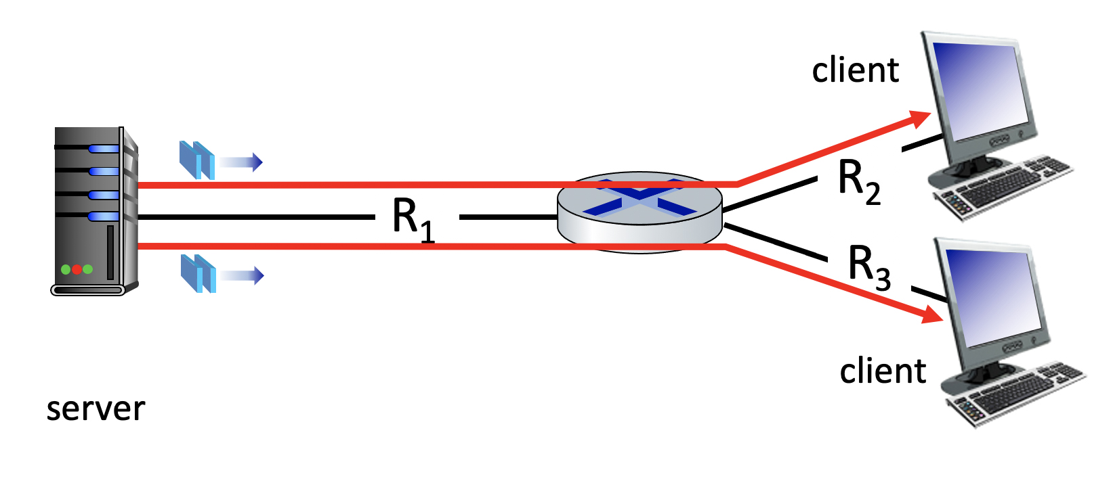
Quiz
IMPORTANT
Performance: Packet Transmission Delay. Consider the network shown below, with a sending server on the left, sending packets to two different client receivers on the right. The sender is sending packets to the receivers over separate TCP connections. The links have transmission rates of R1 = 1 Mbps. Assume that R2 = R3 = 1 Mbps. Assume that the propagation delay is 2 msec per link. Suppose each packet is 1000 bits in size.
What is the end-to-end delay of a packet from when it first begins transmission at the sender, until it is received in full by one of the two clients at the right (the answer is the same for both clients)? Assume store-and-forward packet transmission. You can assume the queueing delay and processing delay are both zero.
ANS: at each link, transmission delay is 1000 bits/1Mbps=1 ms, propagation delay is 2 ms, so delay is 1+2=3 ms.
To traverse all two links, total delay is 3+3=6 ms.
The 2nd stage, packet transmission in parallel.

Slide 11

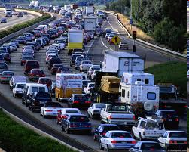
Packet queueing delay (revisited)
a: average packet arrival rate
L: packet length (bits)
R: link bandwidth (bit transmission rate)
average queueing delay
L
a
.
:
arrival rate of bits
“traffic
intensity”
R
service rate of bits
traffic intensity = La/R
1
La/R ~ 0: avg. queueing delay small
La/R -> 1: avg. queueing delay large
La/R > 1: more “work” arriving is more than can be serviced - average delay infinite!
La/R ~ 0
La/R -> 1

Slide 12
“Real” Internet delays and routes
what do “real” Internet delay & loss look like?
traceroute program: provides delay measurement from source to router along end-end Internet path towards destination. For all i:
sends three packets that will reach router i on path towards destination (with time-to-live field value of i)
router i will return packets to sender
sender measures time interval between transmission and reply
3 probes
3 probes
3 probes

Slide 13
Real Internet delays and routes
traceroute: gaia.cs.umass.edu to www.eurecom.fr
3 delay measurements from
gaia.cs.umass.edu to cs-gw.cs.umass.edu
1 cs-gw (128.119.240.254) 1 ms 1 ms 2 ms
2 border1-rt-fa5-1-0.gw.umass.edu (128.119.3.145) 1 ms 1 ms 2 ms
3 cht-vbns.gw.umass.edu (128.119.3.130) 6 ms 5 ms 5 ms
4 jn1-at1-0-0-19.wor.vbns.net (204.147.132.129) 16 ms 11 ms 13 ms
5 jn1-so7-0-0-0.wae.vbns.net (204.147.136.136) 21 ms 18 ms 18 ms
6 abilene-vbns.abilene.ucaid.edu (198.32.11.9) 22 ms 18 ms 22 ms
7 nycm-wash.abilene.ucaid.edu (198.32.8.46) 22 ms 22 ms 22 ms
8 62.40.103.253 (62.40.103.253) 104 ms 109 ms 106 ms
9 de2-1.de1.de.geant.net (62.40.96.129) 109 ms 102 ms 104 ms
10 de.fr1.fr.geant.net (62.40.96.50) 113 ms 121 ms 114 ms
11 renater-gw.fr1.fr.geant.net (62.40.103.54) 112 ms 114 ms 112 ms
12 nio-n2.cssi.renater.fr (193.51.206.13) 111 ms 114 ms 116 ms
13 nice.cssi.renater.fr (195.220.98.102) 123 ms 125 ms 124 ms
14 r3t2-nice.cssi.renater.fr (195.220.98.110) 126 ms 126 ms 124 ms
15 eurecom-valbonne.r3t2.ft.net (193.48.50.54) 135 ms 128 ms 133 ms
16 194.214.211.25 (194.214.211.25) 126 ms 128 ms 126 ms
17 * * *
18 * * *
19 fantasia.eurecom.fr (193.55.113.142) 132 ms 128 ms 136 ms
3 delay measurements
to border1-rt-fa5-1-0.gw.umass.edu
trans-oceanic link
looks like delays decrease! Why?
* means no response (probe lost, router not replying)
* Do some traceroutes from exotic countries at www.traceroute.org

Slide 14
Packet loss
queue (aka buffer) preceding link in buffer has finite capacity
packet arriving to full queue dropped (aka lost)
lost packet may be retransmitted by previous node, by source end system, or not at all
buffer
(waiting area)
A
packet being transmitted
B
packet arriving to
full buffer is lost
* Check out the Java applet for an interactive animation (on publisher’s website) of queuing and loss

Slide 15
Throughput
IMPORTANT
throughput: rate (bits/time unit) at which bits are being sent from sender to receiver
instantaneous: rate at given point in time
average: rate over longer period of time
link capacity
R_{s} bits/sec
link capacity
R_{c} bits/sec
pipe that can carry
fluid at rate
(R_{s} bits/sec)
pipe that can carry
fluid at rate
(R_{c} bits/sec)
server sends bits
(fluid) into pipe
server, with
file of F bits
to send to client

Slide 16
Throughput
IMPORTANT
R_{s} < R_{c} What is average end-end throughput?
R_{s} bits/sec
R_{c} bits/sec
R_{s} > R_{c} What is average end-end throughput?
R_{s} bits/sec
R_{c} bits/sec
bottleneck link
link on end-end path that constrains end-end throughput

Slide 17
Throughput: network scenario
IMPORTANT
per-connection end-end throughput: min(R_{c},R_{s},R/10)
in practice: R_{c} or R_{s} is often bottleneck
R_{s}
R_{s}
R_{s}
R
R_{c}
R_{c}
R_{c}
* Check out the online interactive exercises for more examples: http://gaia.cs.umass.edu/kurose_ross/
10 connections (fairly) share backbone bottleneck link R bits/sec

Slide 18
Additional Questions
https://gaia.cs.umass.edu/kurose_ross/interactive/

Slide 19
Chapter 1: roadmap
What is the Internet?
What is a protocol?
Network edge: hosts, access network, physical media
Network core: packet/circuit switching, internet structure
Performance: loss, delay, throughput
Security
Protocol layers, service models
Notes:
Segue: from performance to security

Slide 20
Network security
IMPORTANT
Internet not originally designed with (much) security in mind
original vision: “a group of mutually trusting users attached to a transparent network” ☺
Internet protocol designers playing “catch-up”
security considerations in all layers!
We now need to think about:
how bad guys can attack computer networks
how we can defend networks against attacks
how to design architectures that are immune to attacks

Slide 21
Network security
IMPORTANT
Internet not originally designed with (much) security in mind
original vision: “a group of mutually trusting users attached to a transparent network” ☺
Internet protocol designers playing “catch-up”
security considerations in all layers!
We now need to think about:
how bad guys can attack computer networks
how we can defend networks against attacks
how to design architectures that are immune to attacks

Slide 22

Bad guys: packet interception
IMPORTANT
packet “sniffing”:
broadcast media (shared Ethernet, wireless)
promiscuous network interface reads/records all packets (e.g., including passwords!) passing by
A
C
src:B dest:A payload
B
Wireshark software used for our end-of-chapter labs is a (free) packet-sniffer

Slide 23
Bad guys: fake identity
IMPORTANT
IP spoofing: injection of packet with false source address
A
C
src:B dest:A payload
B

Slide 24
Bad guys: denial of service
IMPORTANT
Denial of Service (DoS): attackers make resources (server, bandwidth) unavailable to legitimate traffic by overwhelming resource with bogus traffic
1. select target
2. break into hosts around the network (see botnet)
3. send packets to target from compromised hosts
target

Slide 25
Lines of defense:
authentication: proving you are who you say you are
cellular networks provides hardware identity via SIM card; no such hardware assist in traditional Internet
confidentiality: via encryption
integrity checks: digital signatures prevent/detect tampering
access restrictions: password-protected VPNs
firewalls: specialized “middleboxes” in access and core networks:
off-by-default: filter incoming packets to restrict senders, receivers, applications
detecting/reacting to DOS attacks
… lots more on security (throughout, Chapter 8)

Slide 26
Chapter 1: roadmap
What is the Internet?
What is a protocol?
Network edge: hosts, access network, physical media
Network core: packet/circuit switching, internet structure
Performance: loss, delay, throughput
Security
Protocol layers, service models

Slide 27
Protocol “layers” and reference models
Networks are complex,
with many “pieces”:
hosts
routers
links of various media
applications
protocols
hardware, software
Question: is there any hope of organizing structure of network?
and/or our discussion of networks?

Slide 28
Example: organization of air travel
end-to-end transfer of person plus baggage
ticket (purchase)
baggage (check)
gates (load)
runway takeoff
airplane routing
ticket (complain)
baggage (claim)
gates (unload)
runway landing
airplane routing
airplane routing
How would you define/discuss the system of airline travel?
a series of steps, involving many services

Slide 29
Example: organization of air travel
ticket (purchase)
baggage (check)
gates (load)
runway takeoff
airplane routing
ticketing service
ticket (complain)
baggage (claim)
gates (unload)
runway landing
airplane routing
baggage service
gate service
runway service
routing service
airplane routing
layers: each layer implements a service
via its own internal-layer actions
relying on services provided by layer below

Slide 30
Why layering?
Approach to designing/discussing complex systems:
explicit structure allows identification, relationship of system’s pieces
layered reference model for discussion
modularization eases maintenance, updating of system
change in layer's service implementation: transparent to rest of system
e.g., change in gate procedure doesn’t affect rest of system

Slide 31
Layered Internet protocol stack
application: supporting network applications
HTTP, IMAP, SMTP, DNS
transport: process-process data transfer
TCP, UDP
network: routing of datagrams from source to destination
IP, routing protocols
link: data transfer between neighboring network elements
Ethernet, 802.11 (WiFi), PPP
physical: bits “on the wire”
application
application
transport
transport
network
network
link
link
physical
physical

Slide 32
Services, Layering and Encapsulation
application
transport
network
link
physical
M
application
transport
network
link
physical
Application exchanges messages to implement some application service using services of transport layer
H_{t}
M
Transport-layer protocol transfers M (e.g., reliably) from one process to another, using services of network layer
transport-layer protocol encapsulates application-layer message, M, with transport layer-layer header H_{t} to create a transport-layer segment
H_{t} used by transport layer protocol to implement its service
source
destination

Slide 33
Services, Layering and Encapsulation
application
transport
network
link
physical
M
application
transport
network
link
physical
H_{t}
M
Transport-layer protocol transfers M (e.g., reliably) from one process to another, using services of network layer
H_{n}
H_{t}
M
Network-layer protocol transfers transport-layer segment [H_{t} | M] from one host to another, using link layer services
network-layer protocol encapsulates transport-layer segment [H_{t} | M] with network layer-layer header H_{n} to create a network-layer datagram
H_{n} used by network layer protocol to implement its service
source
destination

Slide 34
Services, Layering and Encapsulation
H_{n}
H_{t}
M
application
transport
network
link
physical
M
application
transport
network
link
physical
H_{t}
M
H_{n}
H_{t}
M
Network-layer protocol transfers transport-layer segment [H_{t} | M] from one host to another, using link layer services
H_{l}
H_{n}
H_{t}
M
Link-layer protocol transfers datagram [H_{n}| [H_{t} |M] from host to neighboring host, using network-layer services
link-layer protocol encapsulates network datagram [H_{n}| [H_{t} |M], with link-layer header H_{l} to create a link-layer frame
source
destination

Slide 35





Encapsulation
Matryoshka dolls (stacking dolls)
message
segment
datagram
frame
Credit: https://dribbble.com/shots/7182188-Babushka-Boi
Notes:
Thanks to Nikko Bovornkeeratiroj, Phuthipong <phuthipong@cs.umass.edu>, for the stacking dolls idea and slides

Slide 36
Services, Layering and Encapsulation
application
transport
network
link
physical
application
transport
network
link
physical
message
M
M
segment
H_{t}
M
H_{t}
M
datagram
H_{n}
H_{t}
M
H_{n}
H_{t}
M
frame
H_{l}
H_{n}
H_{t}
M
H_{l}
H_{n}
H_{t}
M
source
destination

Slide 37
Encapsulation: an end-end view
source
message
M
application
transport
network
link
physical
segment
H_{t}
M
H_{t}
datagram
H_{n}
H_{t}
H_{n}
M
frame
H_{l}
H_{n}
H_{t}
M
link
physical
switch
destination
H_{n}
H_{t}
M
network
link
physical
M
application
transport
network
link
physical
H_{l}
H_{n}
H_{t}
M
H_{n}
H_{t}
M
H_{t}
M
H_{n}
H_{t}
M
H_{l}
H_{n}
H_{t}
M
router

Slide 38
Additional Chapter 1 slides

Slide 39
ISO/OSI reference model
Two layers not found in Internet protocol stack!
presentation: allow applications to interpret meaning of data, e.g., encryption, compression, machine-specific conventions
session: synchronization, checkpointing, recovery of data exchange
Internet stack “missing” these layers!
these services, if needed, must be implemented in application
needed?
application
presentation
session
transport
network
link
physical
The seven layer OSI/ISO
reference model

Slide 40
Services, Layering and Encapsulation
application
transport
network
link
physical
M
application
transport
network
link
physical
M
message
H_{t}
M
H_{t}
M
segment
H_{n}
H_{t}
M
H_{n}
H_{t}
M
datagram
H_{l}
H_{n}
H_{t}
M
H_{l}
H_{n}
H_{t}
M
frame
source
destination

Slide 41


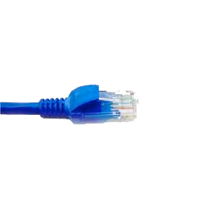
Wireshark
application
(www browser,
email client)
packet
analyzer
application
OS
packet
capture
(pcap)
Transport (TCP/UDP)
Network (IP)
Link (Ethernet)
Physical
copy of all Ethernet frames sent/received

